Slide 1
By Making Community Connections, We Make Art Matter…
Extended Learning Partnerships:
Connecting Art, Academics and the Community

Slide 2
Introductions…
Lauriel Adsit, ArtsTECH Academy Coordinator and Visual Arts Teacher
Andy Zafuto, ArtsTECH Academy Lead Teacher and World History Teacher

Slide 3
Overview of ArtsTECH Academy
California Partnership Academy (school within a school)
3-year program beginning in 10th grade
2 strands from which to choose: Visual Arts and Technology or Theatre Arts
Broad selection of career choices: (Animation, Fashion Design, Architecture, Illustration, Game Design, actor, interior design, Set Design, Script Writer, Graphic Design, Director, Photography, Audio/Video Production, New Media Design)

Slide 4
The Three C’s: Creating Community Connections
Why…
Creating relevance to real world experiences
Connecting to the community develops positive relationships
Career exploration connects high school to college pathways

Slide 5
The Three C’s: Creating Community Connections
How…
Integrated Projects
Museum of Contemporary Art San Diego (MCASD)
The Barking Lot – Dog Rescue Organization

Slide 6
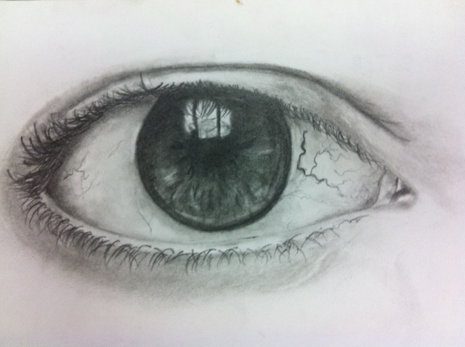
“Learning to Look” Linking Learning and Creating Connections Between Students and Museums
Think Visually

Slide 7
MCASD & ArtsTECH
12th Grade Art & Theatre Students
Integrated units between Art and Language Arts
Overall theme: “REAL OR NOT REAL”
Integrated concepts related to “MEDIA & MEDIUM”
Concepts explored through the lens of Marshall McLuhan’s concept that “the medium is the message”

Slide 8
“LIFELIKE EXHIBITION”
Is it real? Lifelike invites a close examination of works based on commonplace objects and situations, which are startlingly realistic, often playful and sometimes surreal.
“For the message of any medium or technology is the change of scale or pace or pattern that it introduces into human affairs”.
-Marshall McLuhan

Slide 9
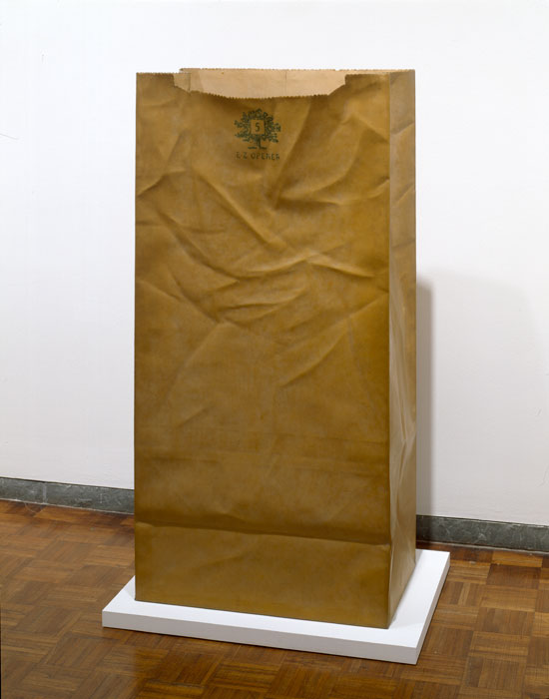

Slide 10
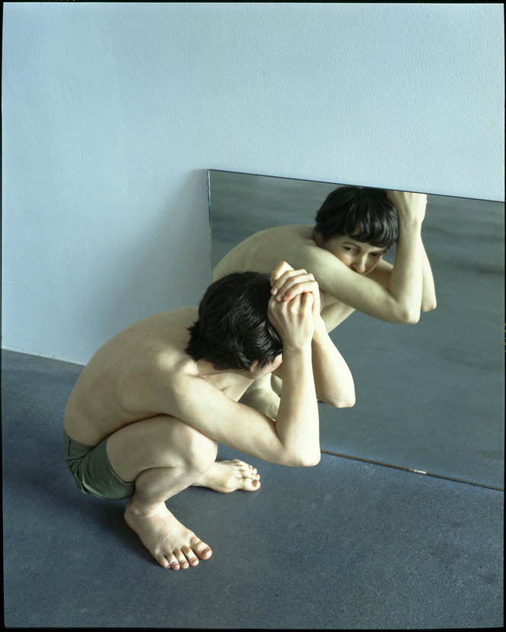

Slide 11
California State Standards
English Language Arts: Employ narrative and descriptive strategies including physical description
Visual Arts: Artistic Perception, Historical and Cultural Context, Aesthetic Valuing

Slide 12
“The Language of the Eye!”
How…
MCASD Gallery Teaching Strategies: Looking at and talking about Art
Learning to Look: Descriptive Writing
“Art does not reproduce what we see. It makes us see.” -Paul Klee

Slide 13
Making the Common Uncommon
Descriptive Writing: Select a common object and describe the object based on a detailed visual description. Do not use the name of the object. Describe only what you “see” and not what you “think”.
Object Poem: Use words from your description to write a poem in free verse. Free verse has no formal structure. Create an image with your words by using sensory details.

Slide 14
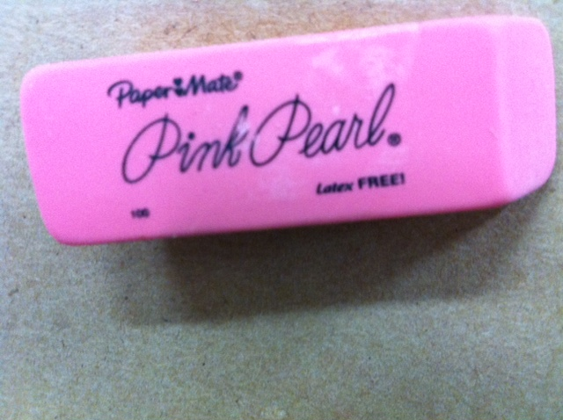
“No ideas but in things”
-William Carlos Williams
Small but vital
To the artist who works on point
There to obliterate
What is out of place
Sacrifices shards of itself
With every clash
By Anthony Perez, Grade 12

Slide 15
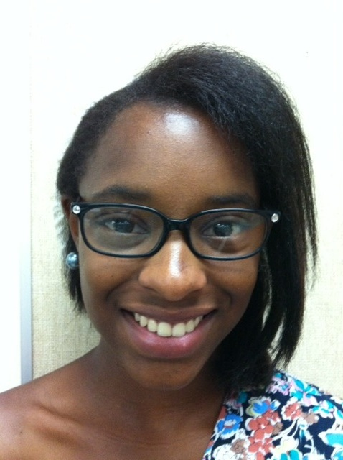
Window
Behind me are the windows to the soul
Plastic frame, skin like coal
I provide aid to a crippled sense
Without my presence, you might be tense
I make your defects known to man
But I’ll show you the world the best I can

Slide 16
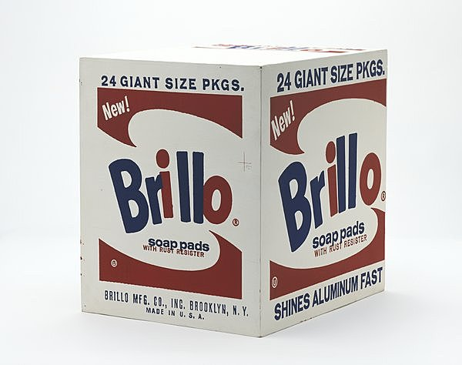
Historical & Cultural Context

Slide 17
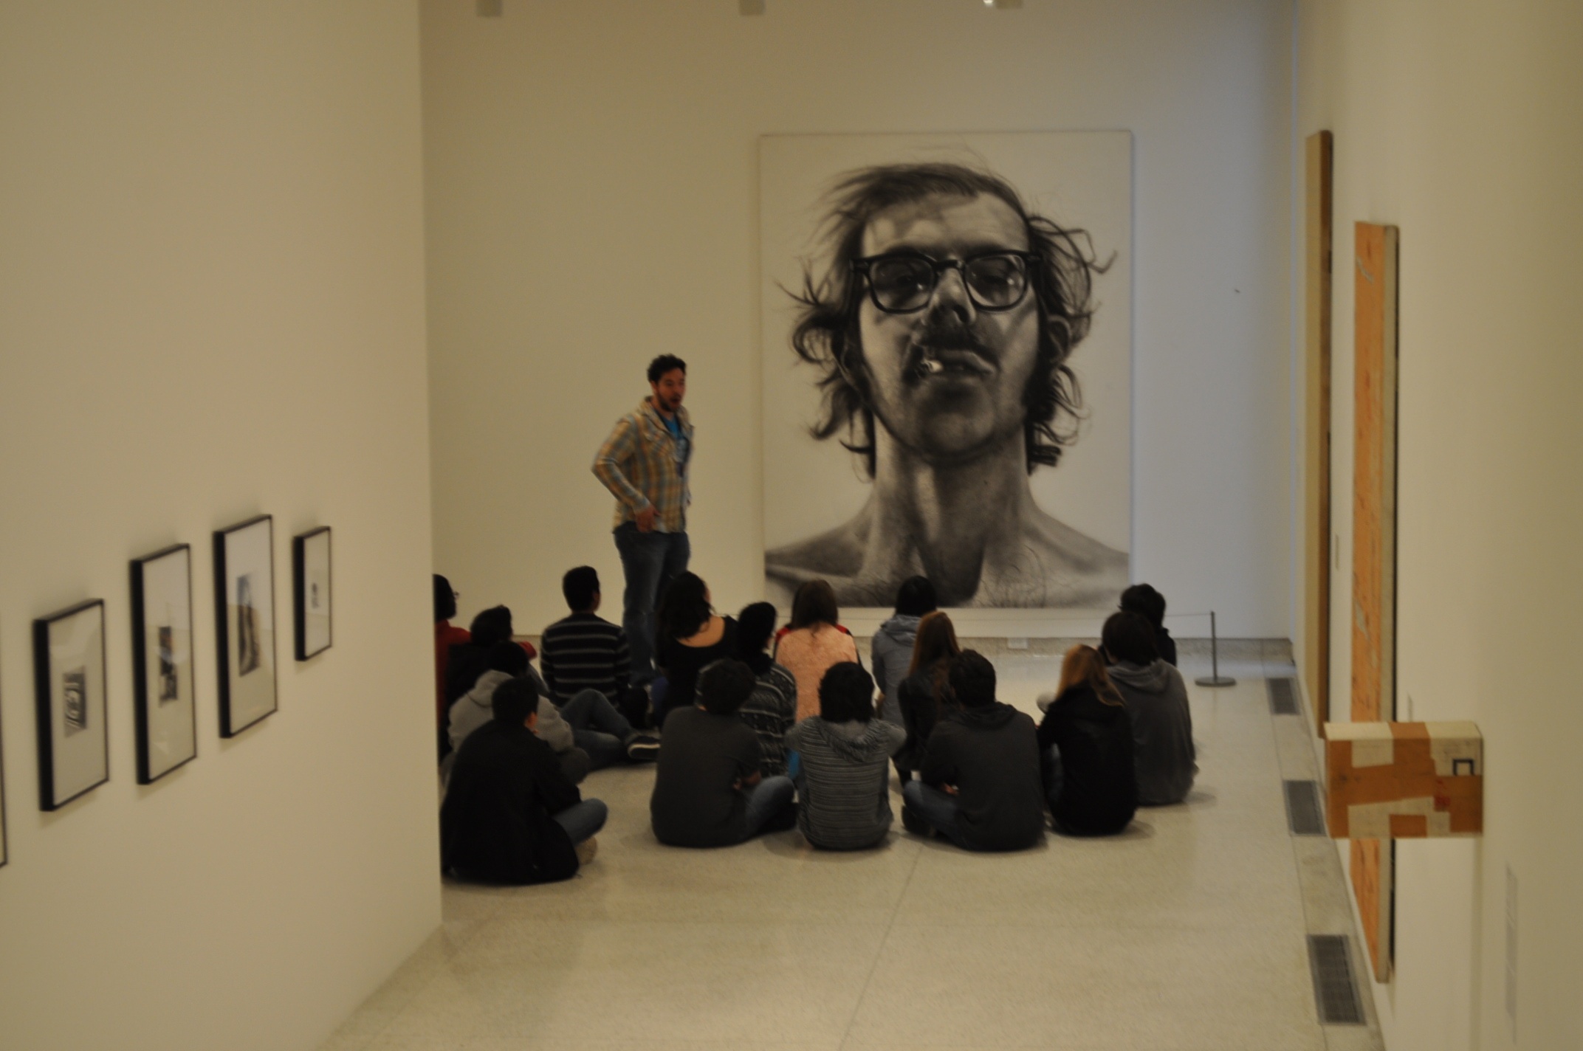
Making Connections

Slide 20
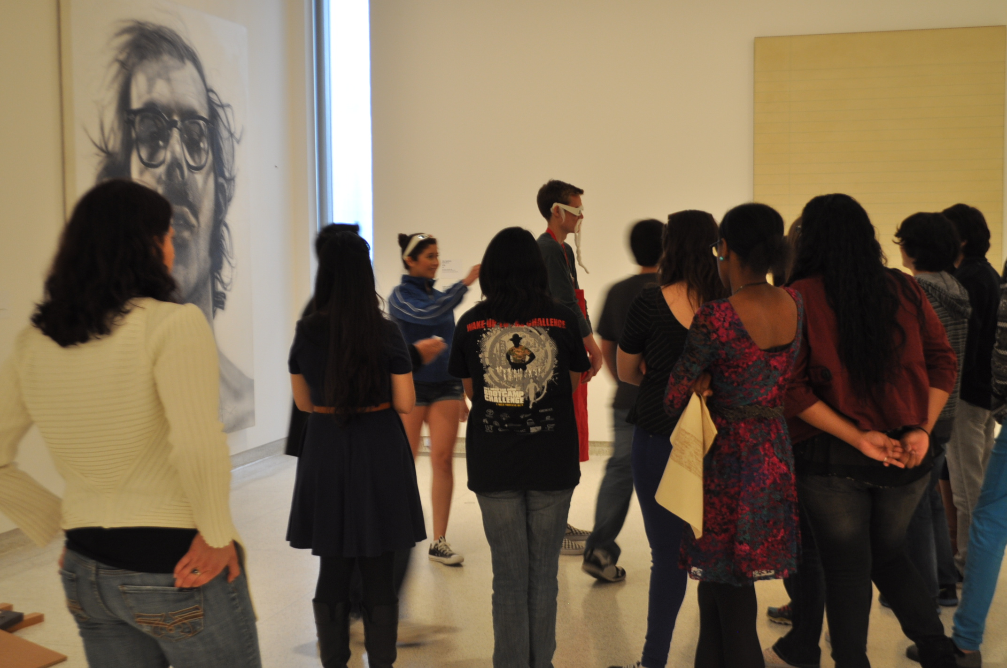
Art Analysis-Making Meaning

Slide 21
Artistic Connections
Creative Expression: Students apply artistic processes and skills using a variety of media to communicate meaning.
“Art is an idea. It is not enough to draw, paint and sculpt. An artist should be able to think.”
-Gordon Woods

Slide 22
Artistic Process-Thinking Visually

Slide 24
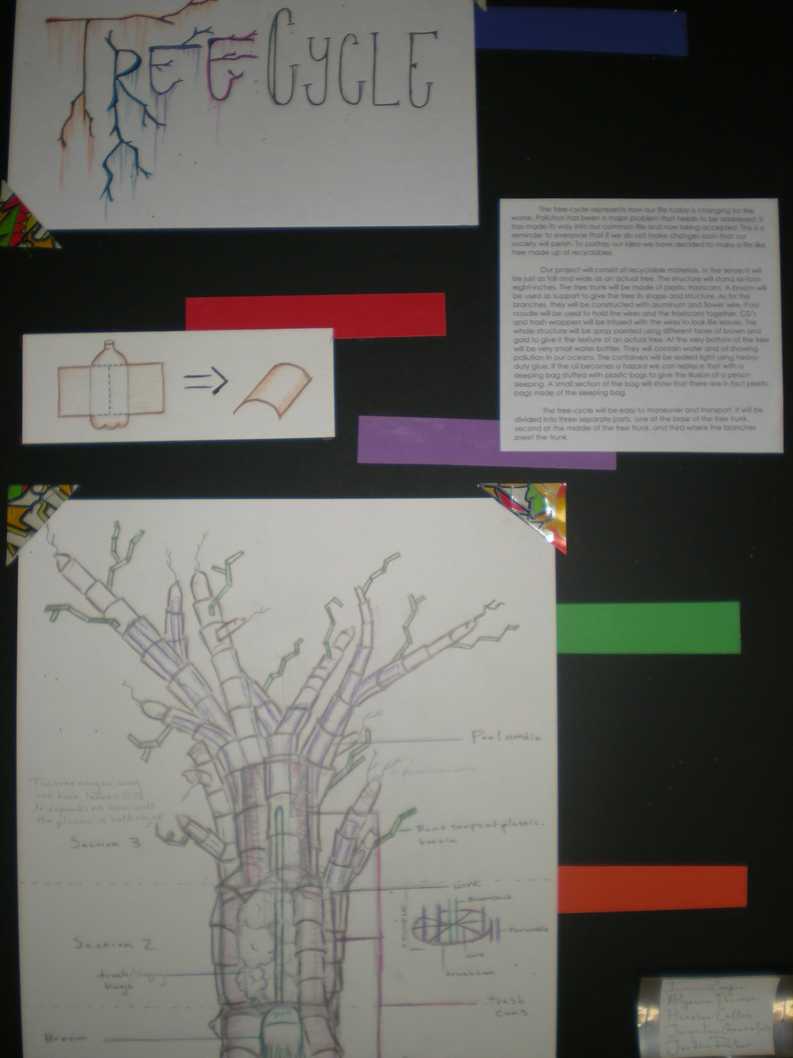

Slide 25
Student Showcase at MCASD La Jolla

Slide 26
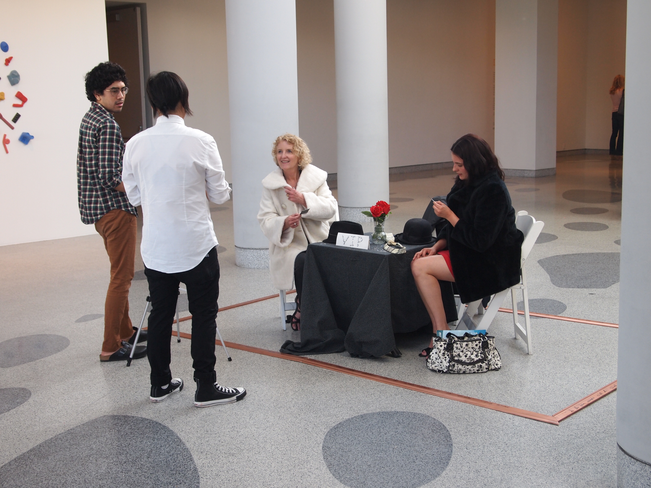

Slide 28
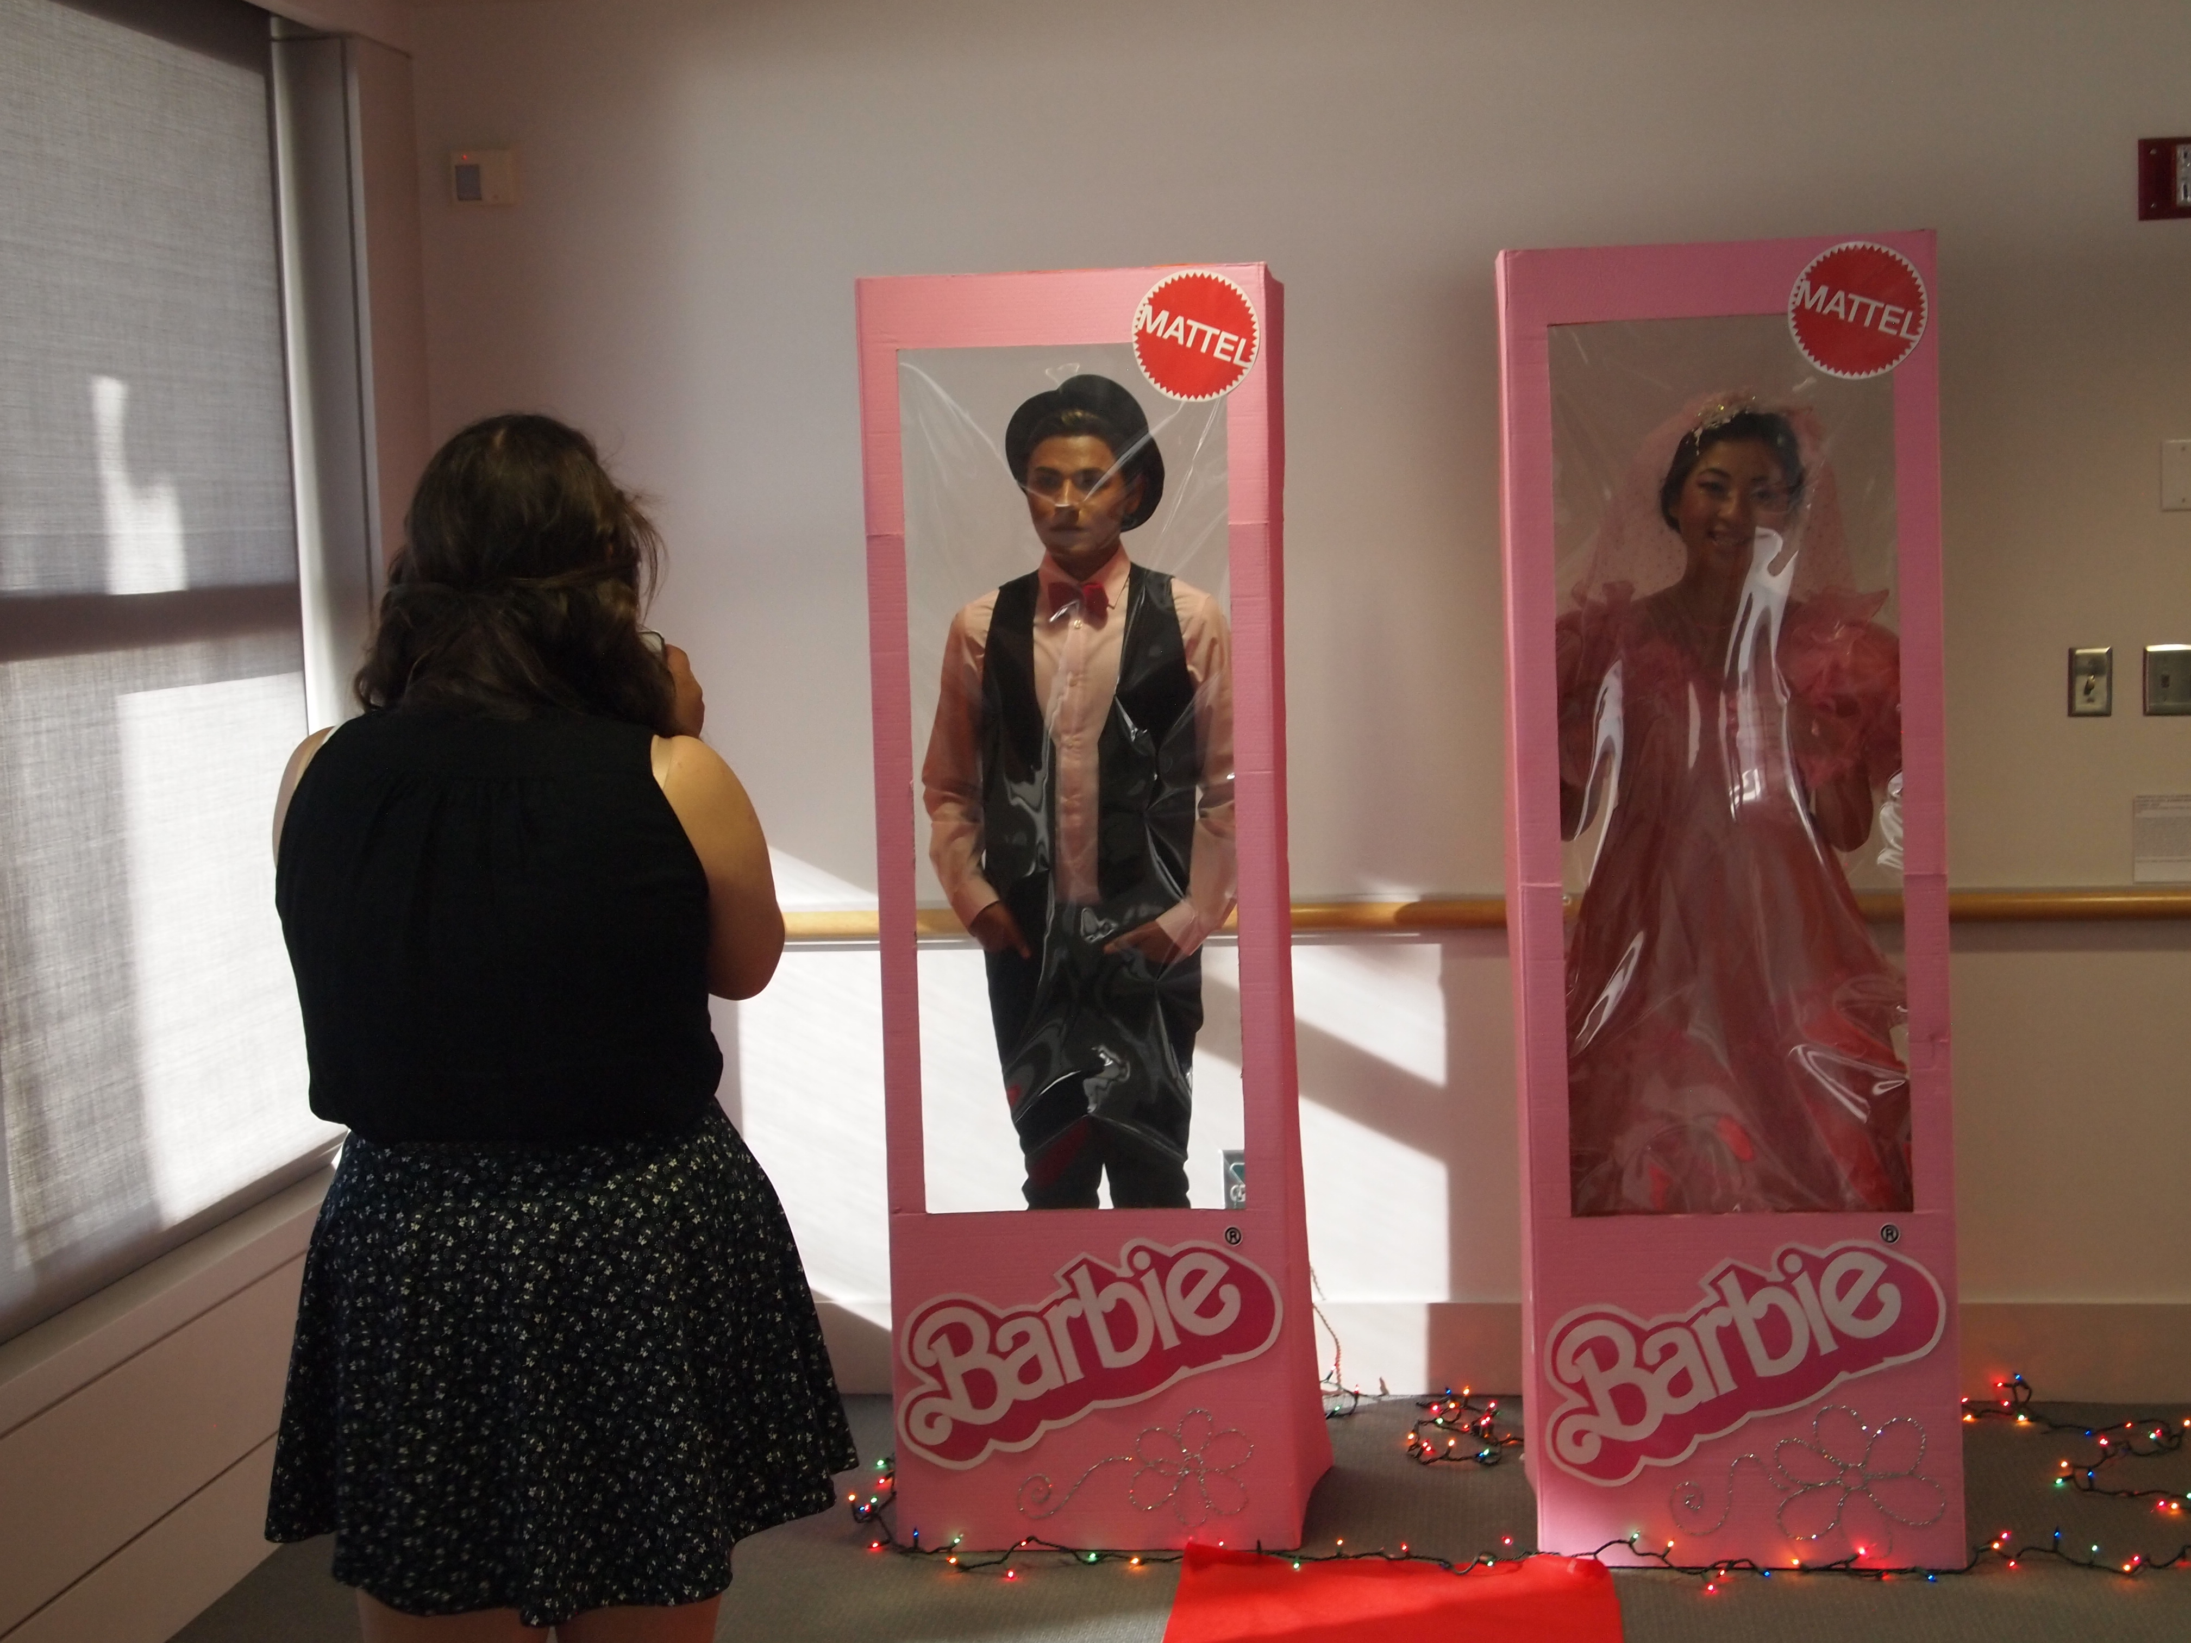

Slide 29
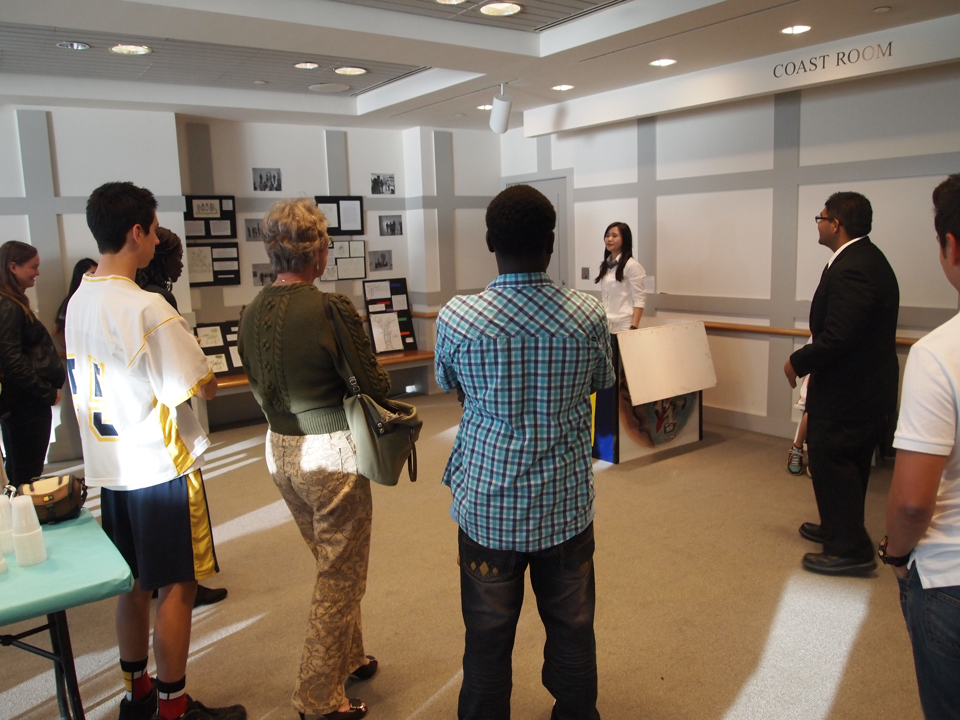

Slide 30
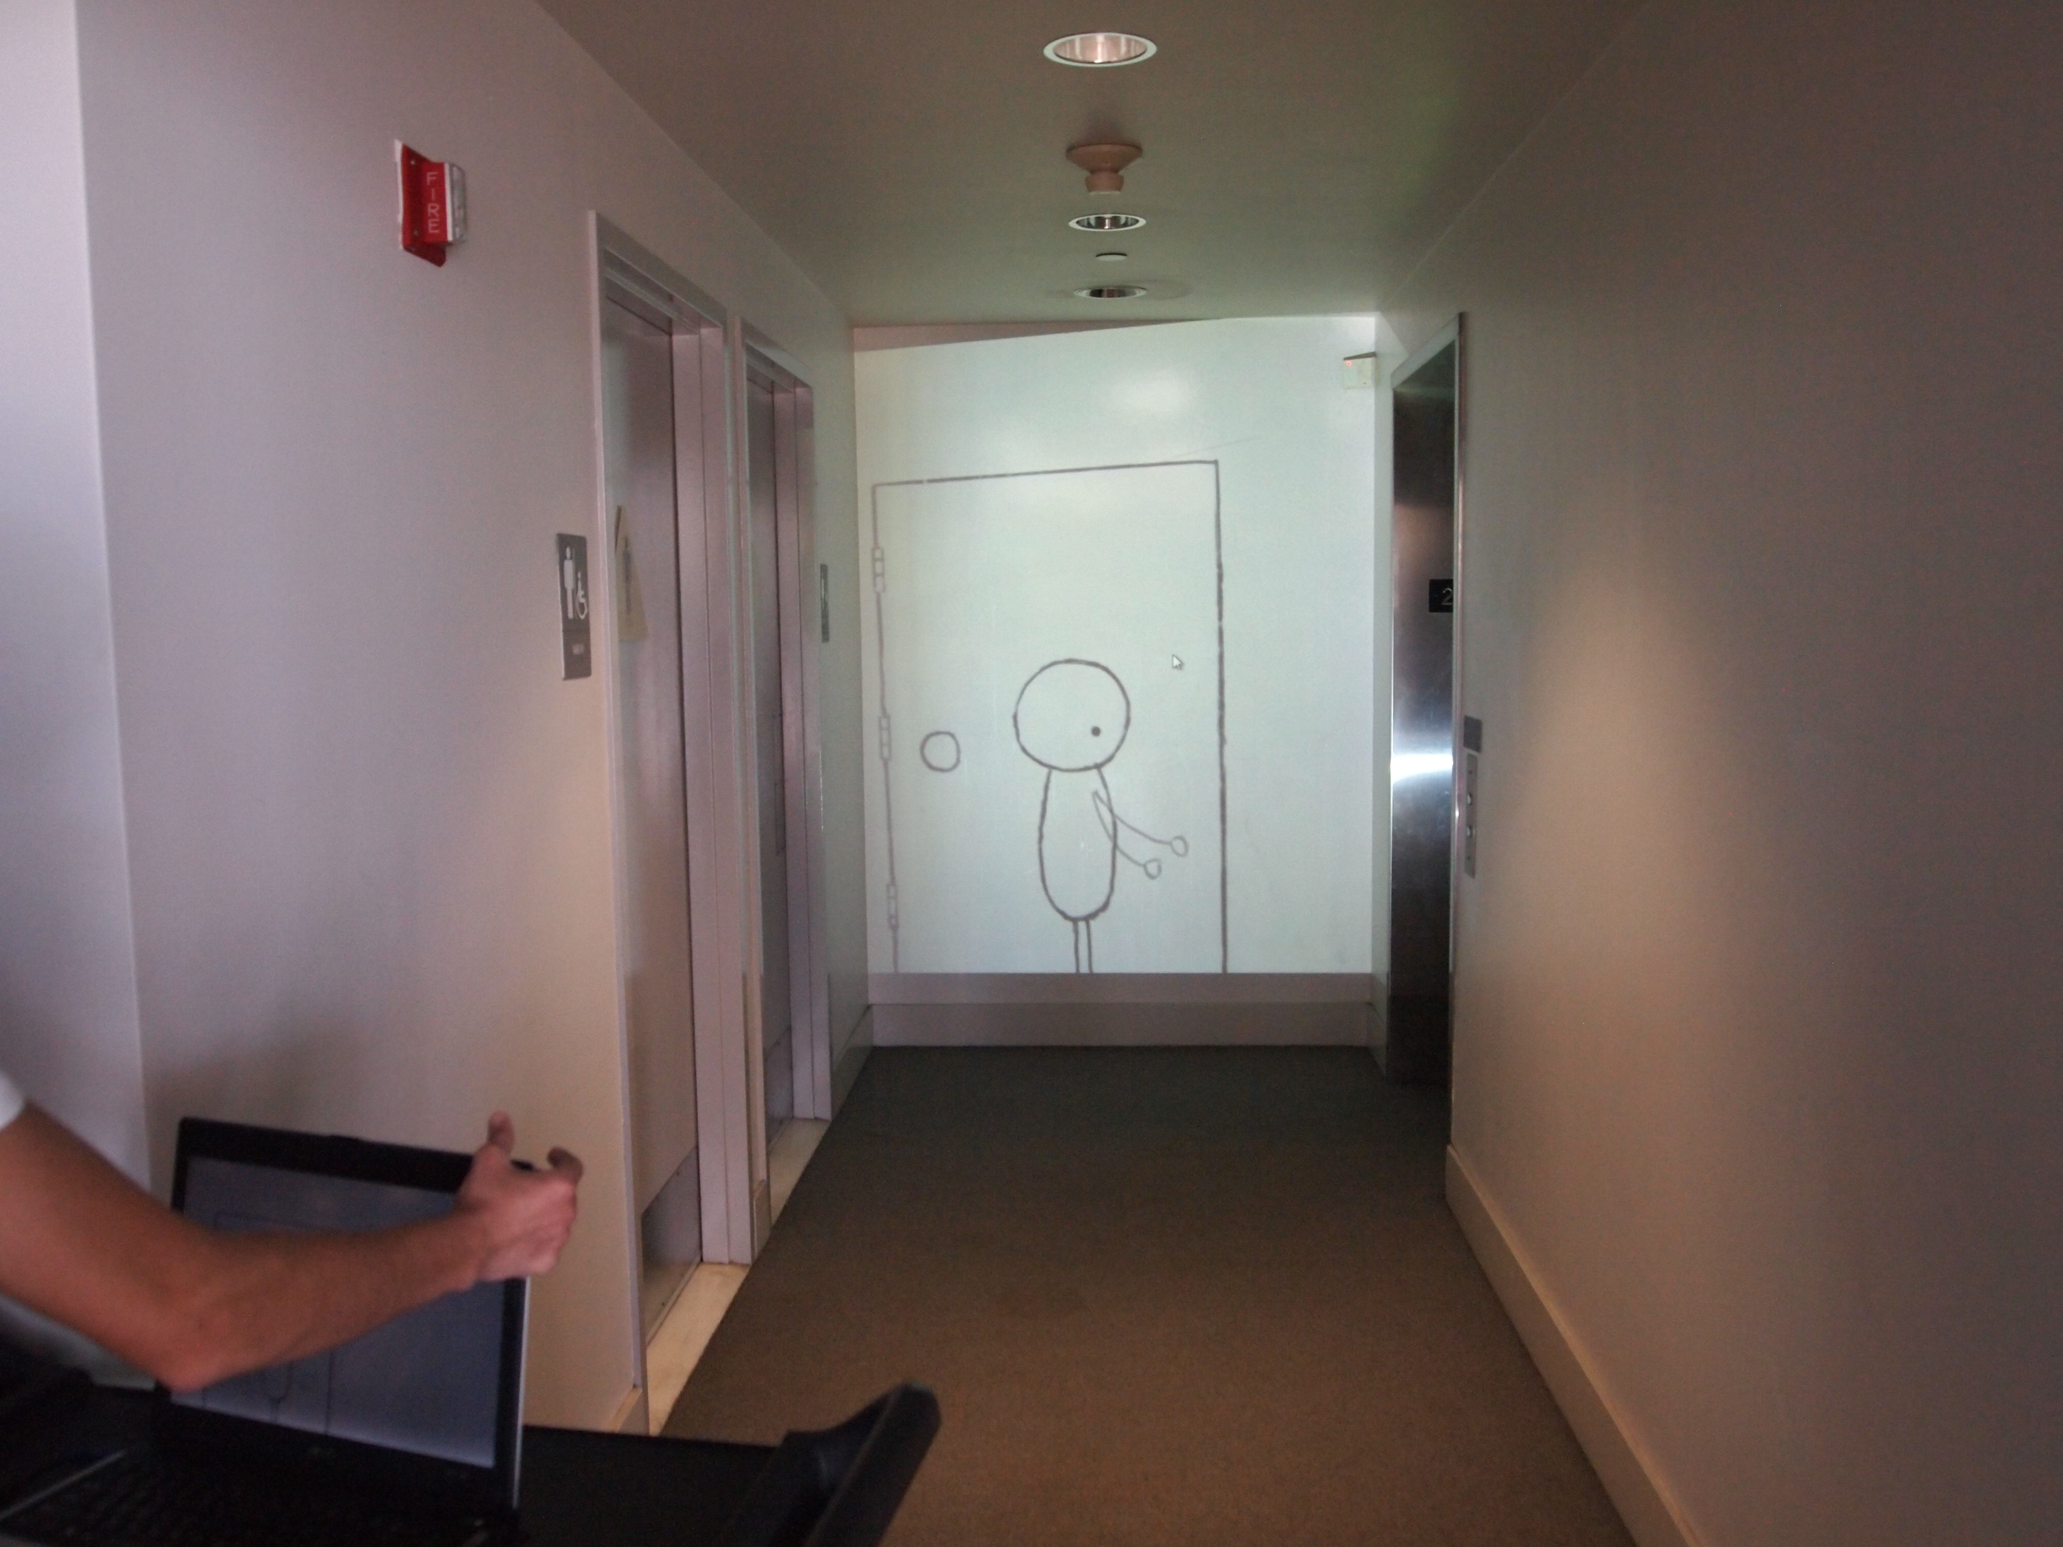

Slide 31
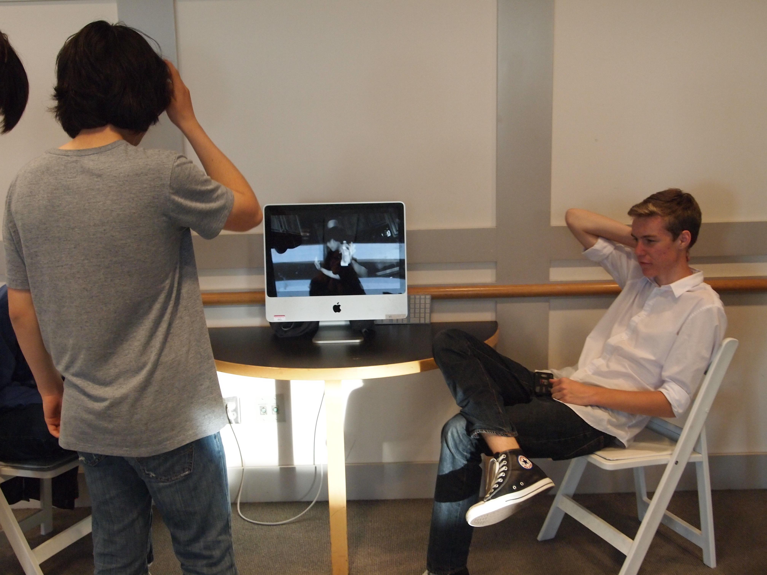

Slide 32
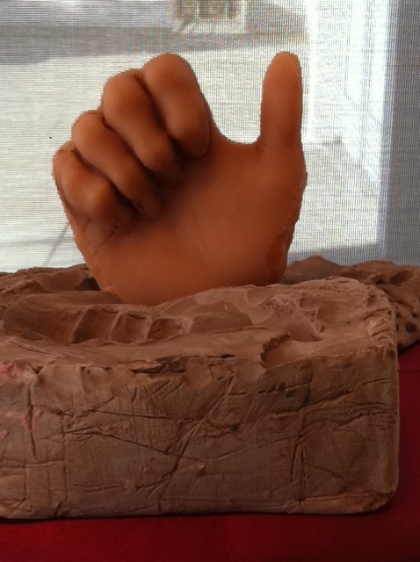

Slide 33
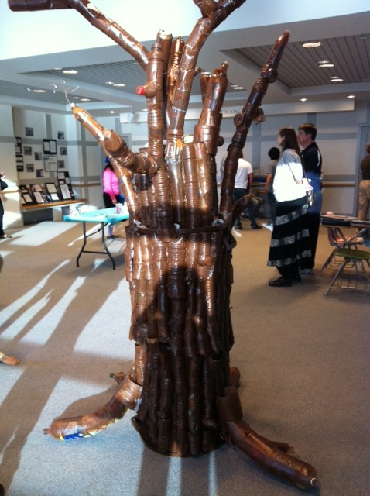

Slide 34
“Poetry gives language a voice,
Art gives it a face”

Slide 35
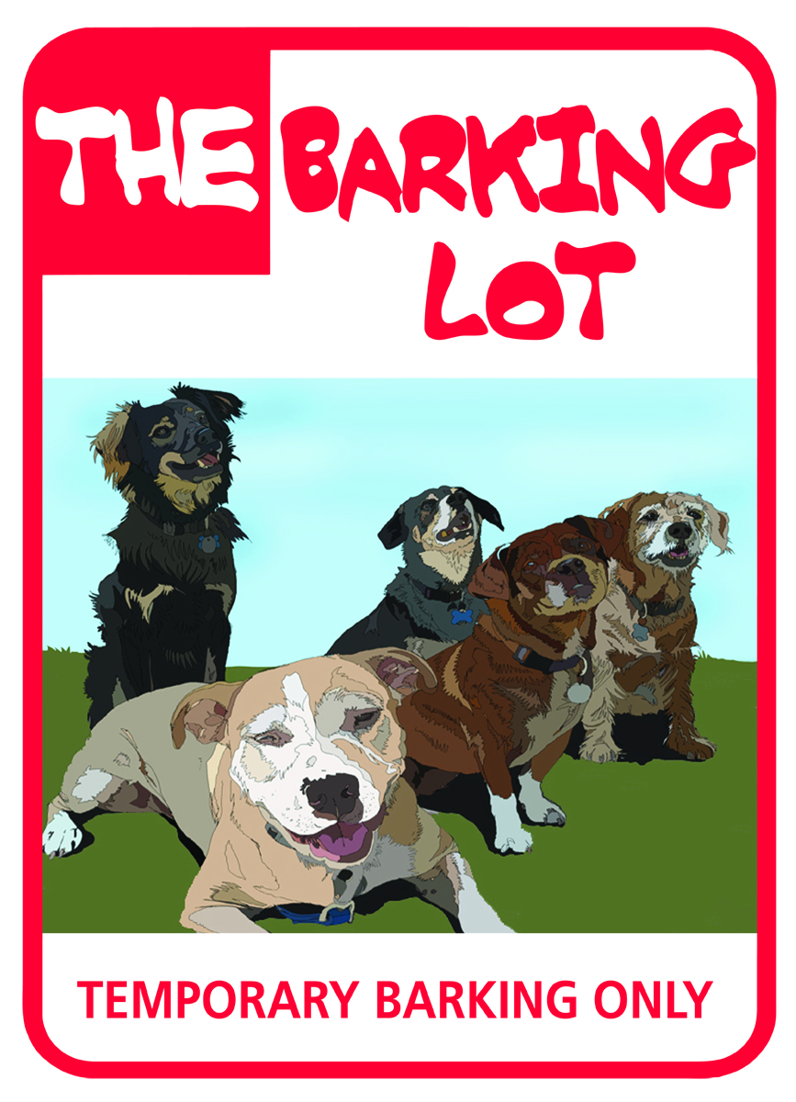
Giving Back to Man’s Best Friend

Slide 36
The Barking Lot & ArtsTECH
10th and 11th Grade Art & Theatre Students
Integrated units between Visual & Performing Arts, World History, and Language Arts
Overall theme: “Giving Back to Man’s Best Friend”
Integrated concepts related to human/canine connection, past and present

Slide 37
The Barking Lot: A No-Kill Shelter
All-Breed Dog Rescue Non-Profit Organization
Rescues dogs from area shelters, humane societies, and Mexico
Strives to find the perfect match between dogs and their new owners
In 6 years, rescued over 1,500 dogs

Slide 40
How can we stop the neglect and abuse of man’s best friend?
1. Theatre Arts/Design in Mixed Media: How can we portray animals in media so that empathy and awareness are created not only within the public at large?
2. Social Studies: What historical events help raise awareness of the importance of dogs and their vast contributions to society?
3. English: How can we use technical writing skills to create informational brochures that will aid in the education of the public?

Slide 41
Academic Connections
History – Study dogs throughout history and learn how the human/canine connection impacts our world
Language Arts – Read novels that feature dogs as main characters and provide responses to literary questions
Theatre Arts/Design in Mixed Media – Learn to use elements of marketing, design, layout, and production to create public service announcements

Slide 42
History Connections
Military Connections – Marine Corp Air Station (MCAS) K-9 Unit Demonstration
Research Project – Dogs In World War II
History References –
The Pawprints of History, Stanley Coren
Planet Dog: A Doglopedia, Sandra and Harry Choron

Slide 43
MCAS Marine K-9 Unit

Slide 49
The Project
Connection to the real world through community service-based learning by supporting and promoting a nonprofit animal rescue center called The Barking Lot
Education of the public and our students regarding humans’ responsibilities toward dogs
Study of canine/human relationships throughout history and recurrent in the arts, humanities and sciences

Slide 50
Public Service Announcements
Students create a media-based campaign consisting of video and claymation PSA’s, which draw awareness to the plight of dogs in rescue facilities and what people can do to help
10th grade students create video production
11th grade students create claymation

